Slide 1
L2d1
Cu boulder
Csci 3155: principles of programming languages
Summer 2018
Spencer wilson
6/11/2018

Slide 2
PLAN
Q&A before class assignment
In class exercise quiz on lab 1 stuff
Grammars
Lab 2
Truethy and falsey
Short circuiting

Slide 3
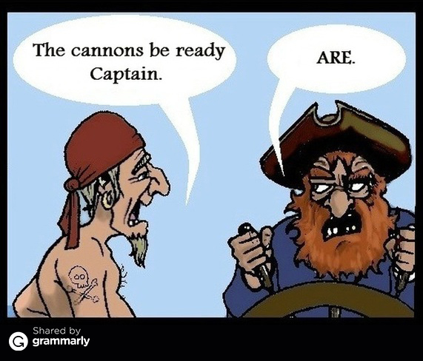

Slide 4
ANNOUNCEMENTS
Thanks for listening last Thursday when I asked you not to pack up yet
That was REALLY cool

Slide 5
ANNOUNCEMENTS
Lab 1 interviews are this week
Lab 2 is due this coming Friday
Lab 3 is going to be released on Wednesday because it has useful material for completing lab 2
University Deadlines :
http://www.colorado.edu/summer/calendars/session-d
June 13 – Last day to drop no W grade recorded or tuition assessed
I would like for all of you to stay in the class but it is up to YOU!

Slide 6
Announcements
The Gist of PL
Updated original doc with some refinement for lab2
Uploaded Chapter 2 as a separate document, for those of you that already have digital notes on Chapter 1 and wouldn’t want to download another full text
I’ll keep this pattern moving forward. Perhaps releasing weekly rather than by chapter.

Slide 7
ANNOUNCEMENTS
Github… Please remove any public records of your solution to Lab1. I’ve posted directions on Piazza on how to push your records to a Github classroom private repository.
We are using GitHub Classroom for Lab2. See the link for the classroom in Lab2. With your teammate, set up an account.
Let me know if there are any issues with this
Git is a version control software. GitHub is a website that uses git. GitHubClassroom is a tool for teachers to provide private repositories to students so that you can practice version control without releasing your homework publicly and spoiling other students opportunity to learn

Slide 8
Lab 1 feedback
Great feedback everyone who completed the survey.
If you haven’t done so already, please look at the lab one goals on piazza for this survey
Lot’s of great advise
Nothing too concerning
I’m happy to speak further about anything in the feedback forms. Just shoot me a line on Piazza or we can meet at Office Hours.

Slide 9
Questions?
?
Before class assignment

Slide 10
In class exercise
A brief quiz on lab 1 topics
15 minutes

Slide 11
How was that
What did we think about this quiz?

Slide 12
What next
Hold onto the quiz.
Take it home and review it.
Check your work.
Bring it back to class tomorrow, we’ll discuss it further.

Slide 13
Brain Teaser – Grammar
Describe the language defined by this grammar. Pick a string of length 5 or 6 that exists in the language and prove it with a parse tree.
S ::= aSa | bSb | ϵ

Slide 14
Lab 2

Slide 15
Types
Lab 1
Lab 2
Numbers
Numbers
Strings
Booleans
Undefined

Slide 16
Language Abilities
Lab 1
Lab 2
Arithmetic (5 function calculator)
Arithmetic
Boolean logic
Concatenation
Printing
Non-mutable variable declarations

Slide 17
Short circuiting

Slide 18
Short circuiting
Short circuiting evaluation is where a programming language does not evaluate the entirety of an expression
In practice this is used when we can know the value of an expression without evaluating the whole expression
It can be observed by observing how expressions with side effects evaluate in the language about a variety of operations

Slide 19
Side effects
Printing to the output stream
Changing memory
( and much more )

Slide 20
JavaScript
console.log(“hello”) // prints hello and returns undefined
console.log(“hello”) && console.log(“bye”)
// what does this do?

Slide 21
JavaScript
console.log(“hello”) // prints hello and returns undefined
console.log(“hello”) && console.log(“bye”)
// prints hello
// returns undefined
// Does NOT print bye

Slide 22
In scala
(”hello”, ”bye”)._2 // evaluates to “bye”:String
var x = 3 // we don’t use var in our programs, its like val but mutable if ( ((x = x + 1 ) , true)._2 && ( x = x + 1 , true )._2) { x } else { x }

Slide 23
In scala
var x = 3 if ( ((x = x + 1 ) , true)._2 && ( x = x + 1 , true )._2) { x } else { x }
// what does this evaluate to?

Slide 24
In scala
var x = 3 if ( ((x = x + 1 ) , true)._2 && ( x = x + 1 , true )._2) { x } else { x }
Evaluates to 5

Slide 25
In scala
var x = 3 if ( ((x = x + 1 ) , false)._2 && ( x = x + 1 , true )._2) { x } else { x }
// What does this evaluate to?

Slide 26
In scala
var x = 3 if ( ((x = x + 1 ) , false)._2 && ( x = x + 1 , true )._2) { x } else { x }
Evaluates to 4

Slide 27
Short circuiting
It’s not unique to JavaScript
It can cause problems if you are not carful
It can be exploited to create clean beautiful code if you are carful

Slide 28
Questions?
?
Short circuiting

Slide 29
Truethy and Falsey

Slide 30
Truethy and Falsey
Some not so technical term “truethy” and “falsey” are commonly excepted terms that describe expressions that, if I were forced to interpret some expression as a Boolean, then the expression is truethy and will cast to True or the expression is falsey and will cast to false

Slide 31
Truethy or falsey
1
0
undefined
NaN
’’
‘false’

Slide 32
JavaScript
console.log(“hello”) // prints hello and returns undefined
console.log(“hello”) && console.log(“bye”)

Slide 33
Short Circuiting
When a subexpression is not executed.
Observable by a lack of side effects
NaN ? console.log(“It is a truethy value”) : console.log(“It is a falsey value”)

Slide 34
Questions?
?
Truethy and Falsey

Slide 35
// TODO
If you have not already, PLEASE complete the lab 1 feedback survey
Check Piazza for the lab 2 goals.
Complete the reading and moodle assignment
Be prepared for your Lab 1 interview.

Slide 36
Ending class
As we end class each day please do wait for me to dismiss you. I promise I’ll let you out on time
After class has ended, if you have questions for me, please remain in your seat rather than crowding the front of the room.
I’m happy to answer questions if I can but the crowding makes me anxious
Sometimes I won’t be able to stick around to answer questions

Slide 37
Lab 2 teams
Does anyone not have a team yet for lab 2?

Slide 38
From now on you will keep your in class exercise

Slide 39
def toBoolean(v: Expr): Boolean = { require(isValue(v)) (v: @unchecked) match { case B(b) => b case N(n) => !(0 == n || n.isNaN()) case N(n) => if (0 == n || n.isNaN()) false else true case _ => ??? } }

Slide 40
